Slide 1

TECHNICAL PRESENTATION
CSA0504- Database Management Systems
PRESENTED BY:
Shree Ranjane K( 192471052)

Slide 2
Q1. Entity-Relationship (ER) Diagram for an Online Library Management System.
What is an ER Diagram?
An Entity Relationship (ER) Diagram is a graphical representation of a database that shows:
Entities – Objects or things (Book, Member).
Attributes – Properties of entities (Book ID, Title).
Relationships – Connections between entities (Borrow, Manages).
Purpose
Organizes database structure.
Reduces data redundancy.
Helps in database design and implementation.
Makes relationships easy to understand.

Slide 3
Relationships
One Member can borrow many Books.
One Book can be borrowed by many members at different times.
Each Borrow Record belongs to one Member.
Each Borrow Record is linked to one Book.
One Librarian manages multiple borrow records.
One Category contains many books.
Each Book belongs to only one Category.

Slide 4
Benefits of ER Diagram
Easy to understand database structure.
Organizes library information efficiently.
Minimizes duplicate data.
Improves data accuracy.
Makes database maintenance easier.
Supports quick book search and issue/return process.

Slide 5
Conclusion
ER Diagram represents the Online Library database visually.
It defines entities, attributes, and relationships clearly.
It improves database organization and management.
It serves as the foundation for developing an Online Library Management System.

Slide 6
Q2. Enhanced Entity-Relationship (EER) Model: Generalization and Specialization Using a University Case Study.
What is an EER Model?
EER stands for Enhanced Entity-Relationship Model.
It is an extension of the traditional ER model.
It represents more complex real-world relationships.
It includes concepts such as:
Generalization
Specialization
Inheritance
It improves database design and flexibility.
Advantages
Models complex data efficiently.
Reduces redundancy.
Supports inheritance of attributes.
Makes database design more organized.

Slide 7
What is Generalization?
Generalization is the process of combining similar entities into one common entity.
It follows a Bottom-Up approach.
Common attributes are moved to a superclass.
Reduces duplicate data.
Simplifies database design.
University Example
Student and Faculty have common information.
Both have:
ID
Name
Email
Phone Number
These common attributes are combined into a Person entity.

Slide 8
What is Specialization?
Specialization is the process of dividing one entity into multiple specialized entities.
It follows a Top-Down approach.
Each subclass inherits the attributes of the superclass.
Each subclass has its own unique attributes.
Example
Consider a Person entity with common attributes such as Person ID, Name, Email, and Phone Number. The Person entity can be specialized into two subclasses: Student – with additional attributes such as Roll Number, Course, Semester, and CGPA.
Faculty – with additional attributes such as Employee ID, Department, Designation, and Salary.
Both Student and Faculty inherit the common attributes from the Person entity while maintaining their own specific details.

Slide 9
Conclusion
EER is an extension of the ER model.
It supports advanced database modeling concepts.
Generalization combines similar entities into a superclass.
Specialization creates subclasses with unique characteristics.
In a University database, the EER model efficiently manages students, faculty, and other users while reducing redundancy and improving data organization.

Slide 10

Q3.Data Independence, DBMS Software Components, and Strong vs Weak Entities
Objectives
Understand the concept of Data Independence.
Learn the software components of a DBMS.
Compare Strong and Weak Entities in ER Modeling.
Study real-world examples of database design.

Slide 11
Introduction to DBMS Architecture
What is a DBMS?
Three-Level DBMS Architecture
A Database Management System (DBMS) is software used to store, manage, retrieve, and manipulate data efficiently.
It acts as an interface between users and the database.
Ensures data security, consistency, and integrity.
Supports multiple users accessing data simultaneously.
External Level: User views of the database.
Conceptual Level: Logical structure of the database.
Internal Level: Physical storage of data.
Benefits
Efficient data management.
Reduced redundancy.
Improved security.
Easy maintenance.

Slide 12
Data Independence
Definition
Importance
Data Independence is the ability to modify the database schema at one level without affecting the next higher level.
It separates data storage from application programs.
Improves flexibility and maintainability.
Simplifies database modifications.
Reduces application maintenance.
Enhances database scalability.
Types
Logical Data Independence
Physical Data Independence

Slide 13
Logical and Physical Data Independence
Logical Data Independence
Physical Data Independence
Ability to modify the conceptual schema without affecting user views.
Changes include adding/removing attributes or tables.
Application programs continue to work without changes.
Ability to modify physical storage without affecting logical schema.
Changes include indexing, file organization, and storage devices.
Examples
Examples
Creating indexes.
Moving database from HDD to SSD.
Compressing database files.
Adding a "Department" table.
Adding a "Phone Number" column to Student.

Slide 14
Significance of Data Independence
Benefits
Reduces impact of database changes.
Improves database flexibility.
Simplifies maintenance.
Enhances system performance.
Supports database growth.
Reduces development cost.
Improves reliability and security.
Comparison
Logical Data Independence
Physical Data Independence
Changes conceptual schema
Changes physical storage
Harder to achieve
Easier to achieve
Affects logical structure
Affects storage only
Example: Add a table
Example: Create an index

Slide 15
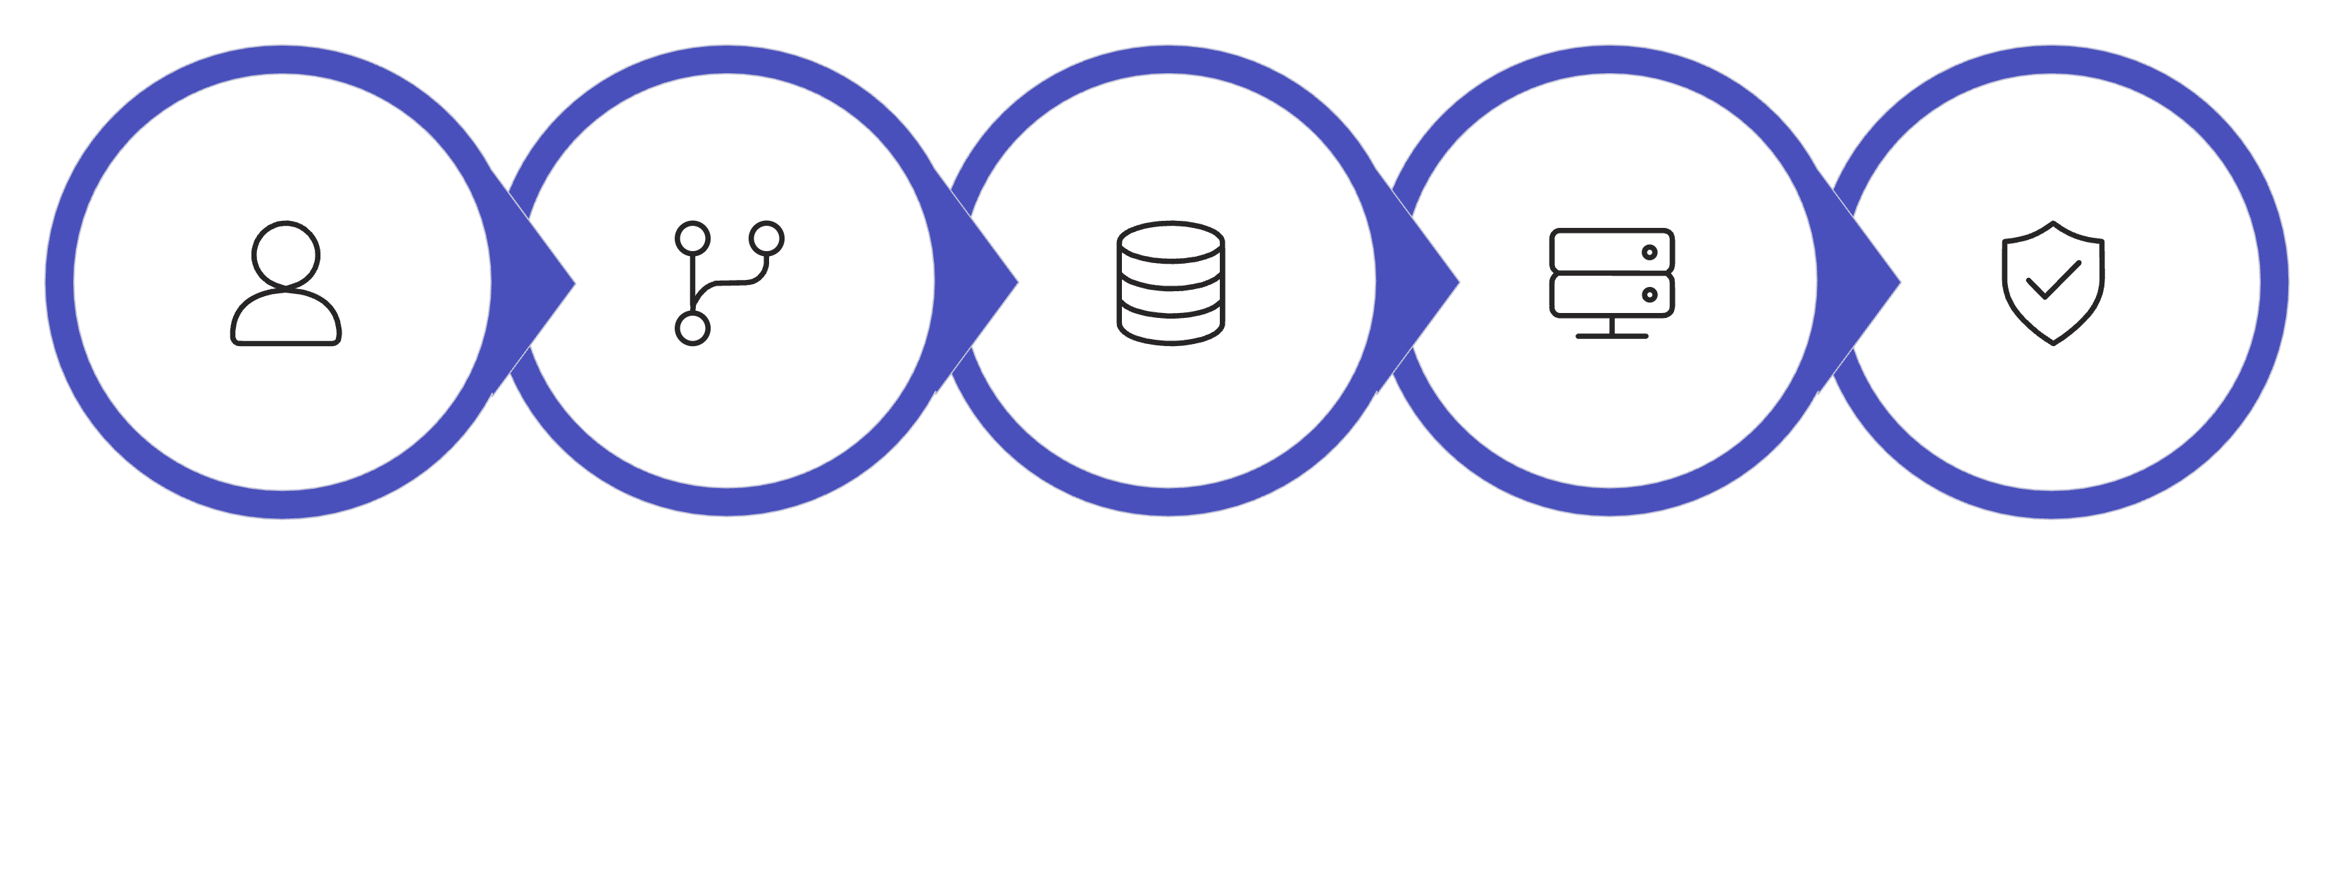
Software Components of DBMS
Main Software Components
Query Processor
Storage Manager
Transaction Manager
Purpose
Execute SQL queries.
Manage data storage.
Ensure secure and reliable transactions.
Working Flow
Query Processor
Storage Manager
Transaction Manager
User
Database

Slide 16
Q4.Query Processor, Storage Manager & Transaction Manager
1
2
3
Query Processor
Storage Manager
Transaction Manager
Accepts SQL queries from users.
Parses and validates SQL statements.
Optimizes query execution.
Executes queries efficiently.
Manages physical storage of data.
Organizes files and indexes.
Retrieves and stores database records.
Handles buffer management.
Manages database transactions.
Ensures ACID properties.
Controls concurrent user access.
Performs commit and rollback operations.

Slide 17
Strong and Weak Entities
Strong Entity
Weak Entity
Has its own Primary Key.
Exists independently.
Can be uniquely identified.
Represented by a single rectangle.
Does not have a complete Primary Key.
Depends on a Strong Entity.
Identified using a partial key.
Represented by a double rectangle.
Examples
Examples
Student
Employee
Book
Customer
Order Item
Dependent
Borrow Record

Slide 18
Q5.Comparison with Real-World Examples
Strong Entity
Weak Entity
Has Primary Key
No complete Primary Key
Exists independently
Depends on Strong Entity
Single Rectangle
Double Rectangle
Strong relationship
Identifying relationship
University Example
Library Example
Strong Entity
Strong Entity
Student
Faculty
Course
Book
Member
Weak Entity
Weak Entity
Borrow Record
Fine Details
Enrollment
Exam Result
Attendance Record

Slide 19
Conclusion
Data Independence
DBMS Components
Ensures flexibility and scalability.
Enable efficient data management.
Strong & Weak Entities
Improve database design accuracy.
Understanding these concepts helps design robust and scalable databases.

